Slide 1
Multiple Peptide Analysis with DL
최정인

Slide 2
Peptide(Gene)
Multiple peptide case gene : THBS1, BTD, ICAM1, LRG1, SERPINA5
AACR 2021 (14)
Patent (14)
NIQSLEVIGK(PPBP)
LLGIETPLPK(ICAM1)
ALLAFQESK(C4BPB)
LSLEIEQLELQR(C4BPA)
GLIDLTLDK(IFRD1)
ELLALIQLER(ECM1)
ILLAELEQLK(VIM)
DTEVLLVGLEPGTR(PTPRJ)
CINQLLCK(SEPP1)
NNLELSTPLK(PROS1)
DLLLPQPDLR(LRG1)
AGFSWIEVTFK(ITIH4)
VFSLQWGEVK(CFI)
DYFIATCK(C1R)
ILSGDPYCEK(BTD)
LSSGLVTAALYGR(BTD)
CA19-9
Bertis (18)
TIVTTLQDSIR(THBS1)
GFLLLASLR(THBS1)
TTSQVRPR(PF4)
IVDLLK(SERPINA5)
DHENELLNK(C2)
VSTLPAITLK(CTSD)
FDPSLTQR(SERPINF2)
LPGIVAEGR(SERPINC1)
AQLLLK(ICAM1)
ASCLYGQLPK(GSTP1)
DFVQPPTK(KNG1)
VAAGAFQGL(LRG1)
VDAETGDVFAIER(CDH5)
FEDENFILK(PPIA)
AFLLTPR(APOM)
GFYFSRPASR(IGF2)
NNLELSTPLK(PROS1)
DLLLPQPDLR(LRG1)
AADDTWEPFASGK
(TTR)
GFQQLLQELNQPR
(SERPINA5)
DSVTGTLPK(KLKB1)
LIQGAPTIR(IGFBP2)
ASSIIDELFQDR
(CLU)
NADYSYSVWK(C5)

Slide 3
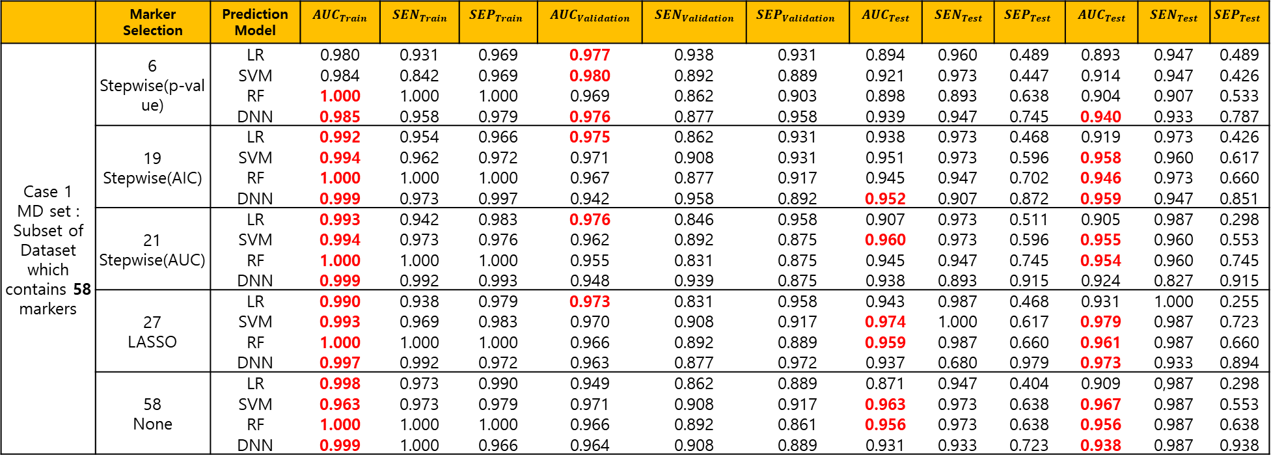
 | Marker Selection | Prediction Model | $$AUC_{Train}$$ | $$SEN_{Train}$$ | $$SEP_{Train}$$ | $$AUC_{Validation}$$ | $$SEN_{Validation}$$ | $$SEP_{Validation}$$ | $$AUC_{Test}$$ | $$SEN_{Test}$$ | $$SEP_{Test}$$ | $$AUC_{Test}$$ | $$SEN_{Test}$$ | $$SEP_{Test}$$
Case 1 MD set : Subset of Dataset which contains 58 markers | 6 Stepwise(p-value) | LR | 0.980 | 0.931 | 0.969 | 0.977 | 0.938 | 0.931 | 0.894 | 0.960 | 0.489 | 0.893 | 0.947 | 0.489
 |  | SVM | 0.984 | 0.842 | 0.969 | 0.980 | 0.892 | 0.889 | 0.921 | 0.973 | 0.447 | 0.914 | 0.947 | 0.426
 |  | RF | 1.000 | 1.000 | 1.000 | 0.969 | 0.862 | 0.903 | 0.898 | 0.893 | 0.638 | 0.904 | 0.907 | 0.533
 |  | DNN | 0.985 | 0.958 | 0.979 | 0.976 | 0.877 | 0.958 | 0.939 | 0.947 | 0.745 | 0.940 | 0.933 | 0.787
 | 19 Stepwise(AIC) | LR | 0.992 | 0.954 | 0.966 | 0.975 | 0.862 | 0.931 | 0.938 | 0.973 | 0.468 | 0.919 | 0.973 | 0.426
 |  | SVM | 0.994 | 0.962 | 0.972 | 0.971 | 0.908 | 0.931 | 0.951 | 0.973 | 0.596 | 0.958 | 0.960 | 0.617
 |  | RF | 1.000 | 1.000 | 1.000 | 0.967 | 0.877 | 0.917 | 0.945 | 0.947 | 0.702 | 0.946 | 0.973 | 0.660
 |  | DNN | 0.999 | 0.973 | 0.997 | 0.942 | 0.958 | 0.892 | 0.952 | 0.907 | 0.872 | 0.959 | 0.947 | 0.851
 | 21 Stepwise(AUC) | LR | 0.993 | 0.942 | 0.983 | 0.976 | 0.846 | 0.958 | 0.907 | 0.973 | 0.511 | 0.905 | 0.987 | 0.298
 |  | SVM | 0.994 | 0.973 | 0.976 | 0.962 | 0.892 | 0.875 | 0.960 | 0.973 | 0.596 | 0.955 | 0.960 | 0.553
 |  | RF | 1.000 | 1.000 | 1.000 | 0.955 | 0.831 | 0.875 | 0.945 | 0.947 | 0.745 | 0.954 | 0.960 | 0.745
 |  | DNN | 0.999 | 0.992 | 0.993 | 0.948 | 0.939 | 0.875 | 0.938 | 0.893 | 0.915 | 0.924 | 0.827 | 0.915
 | 27 LASSO | LR | 0.990 | 0.938 | 0.979 | 0.973 | 0.831 | 0.958 | 0.943 | 0.987 | 0.468 | 0.931 | 1.000 | 0.255
 |  | SVM | 0.993 | 0.969 | 0.983 | 0.970 | 0.908 | 0.917 | 0.974 | 1.000 | 0.617 | 0.979 | 0.987 | 0.723
 |  | RF | 1.000 | 1.000 | 1.000 | 0.966 | 0.892 | 0.889 | 0.959 | 0.987 | 0.660 | 0.961 | 0.987 | 0.660
 |  | DNN | 0.997 | 0.992 | 0.972 | 0.963 | 0.877 | 0.972 | 0.937 | 0.680 | 0.979 | 0.973 | 0.933 | 0.894
 | 58 None | LR | 0.998 | 0.973 | 0.990 | 0.949 | 0.862 | 0.889 | 0.871 | 0.947 | 0.404 | 0.909 | 0,987 | 0.298
 |  | SVM | 0.963 | 0.973 | 0.979 | 0.971 | 0.908 | 0.917 | 0.963 | 0.973 | 0.638 | 0.967 | 0.987 | 0.553
 |  | RF | 1.000 | 1.000 | 1.000 | 0.966 | 0.892 | 0.861 | 0.956 | 0.973 | 0.638 | 0.956 | 0.987 | 0.638
 |  | DNN | 0.999 | 1.000 | 0.966 | 0.964 | 0.908 | 0.889 | 0.931 | 0.933 | 0.723 | 0.938 | 0.987 | 0.938
Logistic regression with AACR markers
AACR | 0.989 (0.004) | 0.972 (0.014) | 0.952 (0.014) | 0.937 (0.018)

Slide 4
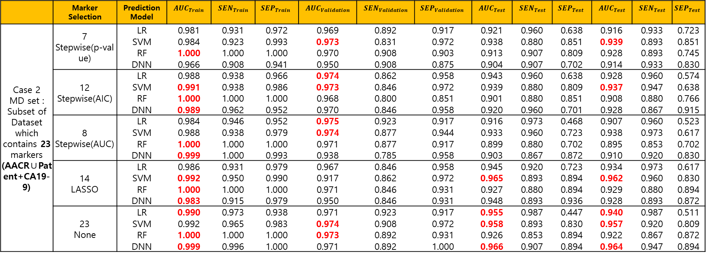
 | Marker Selection | Prediction Model | $$AUC_{Train}$$ | $$SEN_{Train}$$ | $$SEP_{Train}$$ | $$AUC_{Validation}$$ | $$SEN_{Validation}$$ | $$SEP_{Validation}$$ | $$AUC_{Test}$$ | $$SEN_{Test}$$ | $$SEP_{Test}$$ | $$AUC_{Test}$$ | $$SEN_{Test}$$ | $$SEP_{Test}$$
Case 2 MD set : Subset of Dataset which contains 23 markers (AACR∪Patent+CA19-9) | 7 Stepwise(p-value) | LR | 0.981 | 0.931 | 0.972 | 0.969 | 0.892 | 0.917 | 0.921 | 0.960 | 0.638 | 0.916 | 0.933 | 0.723
 |  | SVM | 0.984 | 0.923 | 0.993 | 0.973 | 0.831 | 0.972 | 0.938 | 0.880 | 0.851 | 0.939 | 0.893 | 0.851
 |  | RF | 1.000 | 1.000 | 1.000 | 0.970 | 0.908 | 0.903 | 0.913 | 0.907 | 0.809 | 0.928 | 0.893 | 0.745
 |  | DNN | 0.966 | 0.908 | 0.941 | 0.950 | 0.908 | 0.875 | 0.904 | 0.907 | 0.702 | 0.914 | 0.933 | 0.830
 | 12 Stepwise(AIC) | LR | 0.988 | 0.938 | 0.966 | 0.974 | 0.862 | 0.958 | 0.943 | 0.960 | 0.638 | 0.928 | 0.960 | 0.574
 |  | SVM | 0.991 | 0.938 | 0.986 | 0.973 | 0.846 | 0.972 | 0.939 | 0.880 | 0.809 | 0.937 | 0.947 | 0.638
 |  | RF | 1.000 | 1.000 | 1.000 | 0.968 | 0.800 | 0.851 | 0.901 | 0.880 | 0.851 | 0.908 | 0.880 | 0.766
 |  | DNN | 0.989 | 0.962 | 0.952 | 0.970 | 0.846 | 0.958 | 0.920 | 0.960 | 0.701 | 0.928 | 0.867 | 0.915
 | 8 Stepwise(AUC) | LR | 0.984 | 0.946 | 0.952 | 0.975 | 0.923 | 0.917 | 0.916 | 0.973 | 0.468 | 0.907 | 0.960 | 0.523
 |  | SVM | 0.988 | 0.938 | 0.979 | 0.974 | 0.877 | 0.944 | 0.933 | 0.960 | 0.723 | 0.938 | 0.973 | 0.617
 |  | RF | 1.000 | 1.000 | 1.000 | 0.971 | 0.877 | 0.917 | 0.899 | 0.880 | 0.702 | 0.895 | 0.853 | 0.702
 |  | DNN | 0.999 | 1.000 | 0.993 | 0.938 | 0.785 | 0.958 | 0.903 | 0.867 | 0.872 | 0.910 | 0.920 | 0.830
 | 14 LASSO | LR | 0.986 | 0.931 | 0.979 | 0.967 | 0.846 | 0.958 | 0.945 | 0.920 | 0.723 | 0.934 | 0.973 | 0.617
 |  | SVM | 0.992 | 0.950 | 0.990 | 0.917 | 0.862 | 0.972 | 0.965 | 0.893 | 0.894 | 0.962 | 0.960 | 0.830
 |  | RF | 1.000 | 1.000 | 1.000 | 0.971 | 0.846 | 0.931 | 0.927 | 0.880 | 0.894 | 0.929 | 0.880 | 0.894
 |  | DNN | 0.983 | 0.915 | 0.979 | 0.950 | 0.846 | 0.931 | 0.948 | 0.893 | 0.936 | 0.928 | 0.893 | 0.872
 | 23 None | LR | 0.990 | 0.973 | 0.938 | 0.971 | 0.923 | 0.917 | 0.955 | 0.987 | 0.447 | 0.940 | 0.987 | 0.511
 |  | SVM | 0.992 | 0.965 | 0.983 | 0.974 | 0.908 | 0.972 | 0.958 | 0.893 | 0.830 | 0.957 | 0.920 | 0.809
 |  | RF | 1.000 | 1.000 | 1.000 | 0.973 | 0.892 | 0.931 | 0.926 | 0.853 | 0.894 | 0.922 | 0.867 | 0.872
 |  | DNN | 0.999 | 0.996 | 1.000 | 0.971 | 0.892 | 1.000 | 0.966 | 0.907 | 0.894 | 0.964 | 0.947 | 0.894
Logistic regression with AACR markers
AACR | 0.989 (0.004) | 0.972 (0.014) | 0.952 (0.014) | 0.937 (0.018)

Slide 5
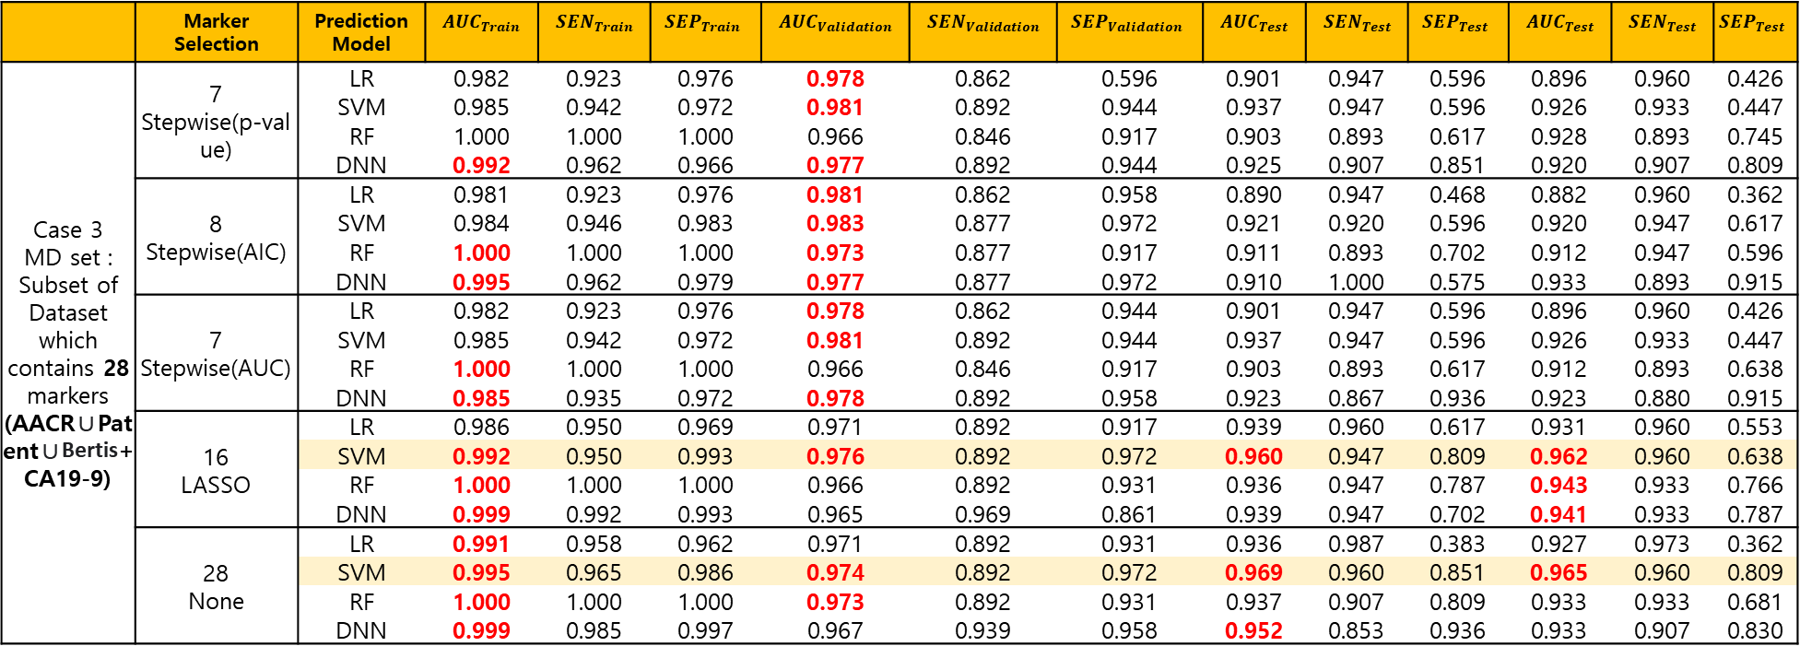
 | Marker Selection | Prediction Model | $$AUC_{Train}$$ | $$SEN_{Train}$$ | $$SEP_{Train}$$ | $$AUC_{Validation}$$ | $$SEN_{Validation}$$ | $$SEP_{Validation}$$ | $$AUC_{Test}$$ | $$SEN_{Test}$$ | $$SEP_{Test}$$ | $$AUC_{Test}$$ | $$SEN_{Test}$$ | $$SEP_{Test}$$
Case 3 MD set : Subset of Dataset which contains 28 markers (AACR∪Patent∪Bertis+CA19-9) | 7 Stepwise(p-value) | LR | 0.982 | 0.923 | 0.976 | 0.978 | 0.862 | 0.596 | 0.901 | 0.947 | 0.596 | 0.896 | 0.960 | 0.426
 |  | SVM | 0.985 | 0.942 | 0.972 | 0.981 | 0.892 | 0.944 | 0.937 | 0.947 | 0.596 | 0.926 | 0.933 | 0.447
 |  | RF | 1.000 | 1.000 | 1.000 | 0.966 | 0.846 | 0.917 | 0.903 | 0.893 | 0.617 | 0.928 | 0.893 | 0.745
 |  | DNN | 0.992 | 0.962 | 0.966 | 0.977 | 0.892 | 0.944 | 0.925 | 0.907 | 0.851 | 0.920 | 0.907 | 0.809
 | 8 Stepwise(AIC) | LR | 0.981 | 0.923 | 0.976 | 0.981 | 0.862 | 0.958 | 0.890 | 0.947 | 0.468 | 0.882 | 0.960 | 0.362
 |  | SVM | 0.984 | 0.946 | 0.983 | 0.983 | 0.877 | 0.972 | 0.921 | 0.920 | 0.596 | 0.920 | 0.947 | 0.617
 |  | RF | 1.000 | 1.000 | 1.000 | 0.973 | 0.877 | 0.917 | 0.911 | 0.893 | 0.702 | 0.912 | 0.947 | 0.596
 |  | DNN | 0.995 | 0.962 | 0.979 | 0.977 | 0.877 | 0.972 | 0.910 | 1.000 | 0.575 | 0.933 | 0.893 | 0.915
 | 7 Stepwise(AUC) | LR | 0.982 | 0.923 | 0.976 | 0.978 | 0.862 | 0.944 | 0.901 | 0.947 | 0.596 | 0.896 | 0.960 | 0.426
 |  | SVM | 0.985 | 0.942 | 0.972 | 0.981 | 0.892 | 0.944 | 0.937 | 0.947 | 0.596 | 0.926 | 0.933 | 0.447
 |  | RF | 1.000 | 1.000 | 1.000 | 0.966 | 0.846 | 0.917 | 0.903 | 0.893 | 0.617 | 0.912 | 0.893 | 0.638
 |  | DNN | 0.985 | 0.935 | 0.972 | 0.978 | 0.892 | 0.958 | 0.923 | 0.867 | 0.936 | 0.923 | 0.880 | 0.915
 | 16 LASSO | LR | 0.986 | 0.950 | 0.969 | 0.971 | 0.892 | 0.917 | 0.939 | 0.960 | 0.617 | 0.931 | 0.960 | 0.553
 |  | SVM | 0.992 | 0.950 | 0.993 | 0.976 | 0.892 | 0.972 | 0.960 | 0.947 | 0.809 | 0.962 | 0.960 | 0.638
 |  | RF | 1.000 | 1.000 | 1.000 | 0.966 | 0.892 | 0.931 | 0.936 | 0.947 | 0.787 | 0.943 | 0.933 | 0.766
 |  | DNN | 0.999 | 0.992 | 0.993 | 0.965 | 0.969 | 0.861 | 0.939 | 0.947 | 0.702 | 0.941 | 0.933 | 0.787
 | 28 None | LR | 0.991 | 0.958 | 0.962 | 0.971 | 0.892 | 0.931 | 0.936 | 0.987 | 0.383 | 0.927 | 0.973 | 0.362
 |  | SVM | 0.995 | 0.965 | 0.986 | 0.974 | 0.892 | 0.972 | 0.969 | 0.960 | 0.851 | 0.965 | 0.960 | 0.809
 |  | RF | 1.000 | 1.000 | 1.000 | 0.973 | 0.892 | 0.931 | 0.937 | 0.907 | 0.809 | 0.933 | 0.933 | 0.681
 |  | DNN | 0.999 | 0.985 | 0.997 | 0.967 | 0.939 | 0.958 | 0.952 | 0.853 | 0.936 | 0.933 | 0.907 | 0.830
Logistic regression with AACR markers
AACR | 0.989 (0.004) | 0.972 (0.014) | 0.952 (0.014) | 0.937 (0.018)

Slide 6
Multiple Peptide
Bertis Marker which we don’t have
Peptide
Gene Name | Peptide Sequence | Correlation
CLU | ASSIIDELFQDR | 0.73
 | TLLSNLEEAK
C5 | NADYSYSVWK | 0.78
 | GGSASTWLTAFALR
LRG1 | DLLLPQPDLR | 0.96
 | VAAGAFQGLR
ITIH4 | AGFSWIEVTFK | 0.77
 | LALDNGGLAR
BTD | ILSGDPYCEK | 0.92
 | LSSGLVTAALYGR
PPBP | NIQSLEVIGK | 0.83
 | ICLDPDAPR
SERPINC1 | IEDGFSLK | 0.84
 | VAEGTQVLELPFK
LDHB | GLTSVINQK | 0.79
 | IVVVTAGVR
CFH | GEWVALNPLR | 0.79
 | TGESVEFVCK
C4BPA | LSLEIEQLELQR | 0.88
 | TWYPEVPK
APOC1 | EFGNTLEDK | 0.91
 | EWFSETFQK
THBS1 | GFLLLASLR | 0.83
 | TIVTTLQDSIR
IGFBP3 | ALAQCAPPPAVCAELVR | 0.65
 | YGQPLPGYTTK
Gene Name | Peptide Sequence
TTR | AADDTWEPFASGK
KLKB1 | DSVTGTLPK
IGFBP2 | LIQGAPTIR
PROS1 | NNLELSTPLK
CFI | VFSLQWGEVK
C1R | DYFIATCK
C4BPB | ALLAFQESK
SOD3 | VTGVVLFR
MBL2 | FQASVATPR
ITIH2 | IQPSGGTNINEALLR
HRG | DGYLFQLLR
CTSD | VSTLPAITLK
C7 | VLFYVDSEK
C6 | TLNICEVGTIR
APOH | VCPFAGILENGAVR
AGT | DPTFIPAPIQAK
IFRD1 | GLIDLTLDK
ADIPOQ | GDIGETGVPGAEGPR
ECM1 | ELLALIQLER
C1S | TNFDNDIALVR
GSTP1 | ASCLYGQLPK
CORO1C | CDLISIPK
VIM | ILLAELEQLK
PTPRJ | DTEVLLVGLEPGTR
PKM2 | CDENILWLDYK
FCGBP | FAVLQENVAWGNGR
CPN2 | LSNNALSGLPQGVFGK
COL4A2 | GLPGEVLGAQPGPR
SERPINA5 | GFQQLLQELNQPR
SEPP1(SELENOP) | CINQLLCK
ICAM1 | LLGIETPLPK
Gene Name | Peptide Sequence
SERPINA5 | IVDLLK
SEPP1(SELENOP) | DDFLIYDR
ICAM1 | AQLLLK
SERPINC1 | LPGIVAEGR
CDH5 | VDAETGDVFAIER
PPIA | FEDENFILK
C2 | DHENELLNK
SERPINF2 | FDPSLTQR
KNG1 | DFVQPPTK
PF4 | TTSQVRPR
APOM | AFLLTPR
IGF2 | GFYFSRPASR

Slide 7
Marker Selection
 | Marker Selection | Selected Marker
Case 1 MD set : Subset of Dataset which contains 58 peptide markers | 6 Stepwise(p-value) | "Y ~ CA19_9 + LIQGAPTIR + TIVTTLQDSIR + NADYSYSVWK + ASSIIDELFQDR + DSVTGTLPK"
 | 19 Stepwise(AIC) | "Y ~ CA19_9 + ICLDPDAPR + GLPGEVLGAQPGPR + LIQGAPTIR + ASSIIDELFQDR + NADYSYSVWK + DSVTGTLPK + GFQQLLQELNQPR + LLGIETPLPK + NIQSLEVIGK + GLTSVINQK + DTEVLLVGLEPGTR + ELLALIQLER + LSLEIEQLELQR + ALLAFQESK + DYFIATCK + TNFDNDIALVR + IEDGFSLK + GGSASTWLTAFALR"
 | 21 Stepwise(AUC) | "Y ~ CA19_9 + LIQGAPTIR + GLPGEVLGAQPGPR + TIVTTLQDSIR + ALAQCAPPPAVCAELVR + NADYSYSVWK + ASSIIDELFQDR + VSTLPAITLK + DSVTGTLPK + LLGIETPLPK + LSLEIEQLELQR + NIQSLEVIGK + ELLALIQLER + ALLAFQESK + DYFIATCK + TNFDNDIALVR + IEDGFSLK + GGSASTWLTAFALR + DPTFIPAPIQAK + DTEVLLVGLEPGTR + GLTSVINQK"
 | 27 LASSO | "Y ~ CA19_9 + AADDTWEPFASGK + ALAQCAPPPAVCAELVR + ASSIIDELFQDR + CDENILWLDYK + CINQLLCK + DSVTGTLPK + DTEVLLVGLEPGTR + DYFIATCK + ELLALIQLER + GDIGETGVPGAEGPR + GFQQLLQELNQPR + GGSASTWLTAFALR + GLIDLTLDK + GLPGEVLGAQPGPR + GLTSVINQK + ICLDPDAPR + IEDGFSLK + ILLAELEQLK + LIQGAPTIR + LLGIETPLPK + LSLEIEQLELQR + NADYSYSVWK + NIQSLEVIGK + TIVTTLQDSIR + TLLSNLEEAK + VLFYVDSEK"
 | 58 None | "Y ~ CA19_9 + AADDTWEPFASGK + AGFSWIEVTFK + ALAQCAPPPAVCAELVR + ALLAFQESK + ASCLYGQLPK + ASSIIDELFQDR + CDENILWLDYK + CDLISIPK + CINQLLCK + DGYLFQLLR + DLLLPQPDLR + DPTFIPAPIQAK + DSVTGTLPK + DTEVLLVGLEPGTR + DYFIATCK + EFGNTLEDK + ELLALIQLER + EWFSETFQK + FAVLQENVAWGNGR + FQASVATPR + GDIGETGVPGAEGPR + GEWVALNPLR + GFLLLASLR + GFQQLLQELNQPR + GGSASTWLTAFALR + GLIDLTLDK + GLPGEVLGAQPGPR + GLTSVINQK + ICLDPDAPR + IEDGFSLK + ILLAELEQLK + ILSGDPYCEK + IQPSGGTNINEALLR + IVVVTAGVR + LALDNGGLAR + LIQGAPTIR + LLGIETPLPK + LSLEIEQLELQR + LSNNALSGLPQGVFGK + LSSGLVTAALYGR + NADYSYSVWK + NIQSLEVIGK + NNLELSTPLK + TGESVEFVCK + TIVTTLQDSIR + TLLSNLEEAK + TLNICEVGTIR + TNFDNDIALVR + TWYPEVPK + VAAGAFQGLR + VAEGTQVLELPFK + VCPFAGILENGAVR + VFSLQWGEVK + VLFYVDSEK + VSTLPAITLK + VTGVVLFR + YGQPLPGYTTK"
Case 4 MD set : Subset of Dataset which contains 45 protein markers by averaged peptide. | 7 Stepwise(p-value) | "Y ~ CA19_9 + LIQGAPTIR + GLPGEVLGAQPGPR + THBS1 + C5 + CLU + DSVTGTLPK"
 | 8 Stepwise(AIC) | "Y ~ CA19_9 + LIQGAPTIR + GLPGEVLGAQPGPR + THBS1 + DGYLFQLLR + LLGIETPLPK + CLU + C5"
 | 12 Stepwise(AUC) | "Y ~ CA19_9 + LIQGAPTIR + GLPGEVLGAQPGPR + THBS1 + DGYLFQLLR + LLGIETPLPK + ELLALIQLER + C5 + CLU + PPBP + SERPINC1 + DPTFIPAPIQAK"
 | 30 LASSO | "Y ~ CA19_9 + AADDTWEPFASGK + ASCLYGQLPK + CDENILWLDYK + CDLISIPK + CINQLLCK + DPTFIPAPIQAK + DSVTGTLPK + DTEVLLVGLEPGTR + DYFIATCK + ELLALIQLER + FAVLQENVAWGNGR + GDIGETGVPGAEGPR + GFQQLLQELNQPR + GLIDLTLDK + GLPGEVLGAQPGPR + ILLAELEQLK + LIQGAPTIR + LLGIETPLPK + VLFYVDSEK + CLU + C5 + LRG1 + ITIH4 + PPBP + SERPINC1 + LDHB + C4BPA + THBS1 + IGFBP3"
 | 45 None | "Y ~ CA19_9 + AADDTWEPFASGK + ALLAFQESK + ASCLYGQLPK + CDENILWLDYK + CDLISIPK + CINQLLCK + DGYLFQLLR + DPTFIPAPIQAK + DSVTGTLPK + DTEVLLVGLEPGTR + DYFIATCK + ELLALIQLER + FAVLQENVAWGNGR + FQASVATPR + GDIGETGVPGAEGPR + GFQQLLQELNQPR + GLIDLTLDK + GLPGEVLGAQPGPR + ILLAELEQLK + IQPSGGTNINEALLR + LIQGAPTIR + LLGIETPLPK + LSNNALSGLPQGVFGK + NNLELSTPLK + TLNICEVGTIR + TNFDNDIALVR + VCPFAGILENGAVR + VFSLQWGEVK + VLFYVDSEK + VSTLPAITLK + VTGVVLFR + CLU + C5 + LRG1 + ITIH4 + BTD + PPBP + SERPINC1 + LDHB + CFH + C4BPA + APOC1 + THBS1 + IGFBP3"

Slide 8
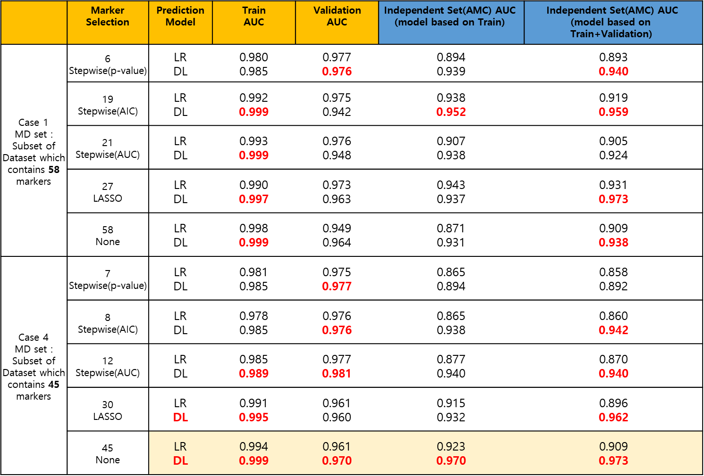
Result
 | Marker Selection | Prediction Model | $$\text{Train}$$ $$\text{AUC}$$ | $$\text{Validation}$$ $$\text{AUC}$$ | $$\text{Independent} \text{Set}\text{(}\text{AMC}\text{) }\text{AUC}$$ $$\text{(}\text{model} \text{based} \text{on} \text{Train}\text{)}$$ | $$\text{Independent} \text{Set}\text{(}\text{AMC}\text{) }\text{AUC}$$ $$\text{(}\text{model} \text{based} \text{on} \text{Train}\text{+}\text{Validation}\text{)}$$
Case 1 MD set : Subset of Dataset which contains 58 markers | 6 Stepwise(p-value) | LR DL | 0.980 0.985 | 0.977 0.976 | 0.894 0.939 | 0.893 0.940
 | 19 Stepwise(AIC) | LR DL | 0.992 0.999 | 0.975 0.942 | 0.938 0.952 | 0.919 0.959
 | 21 Stepwise(AUC) | LR DL | 0.993 0.999 | 0.976 0.948 | 0.907 0.938 | 0.905 0.924
 | 27 LASSO | LR DL | 0.990 0.997 | 0.973 0.963 | 0.943 0.937 | 0.931 0.973
 | 58 None | LR DL | 0.998 0.999 | 0.949 0.964 | 0.871 0.931 | 0.909 0.938
Case 4 MD set : Subset of Dataset which contains 45 markers | 7 Stepwise(p-value) | LR DL | 0.981 0.985 | 0.975 0.977 | 0.865 0.894 | 0.858 0.892
 | 8 Stepwise(AIC) | LR DL | 0.978 0.985 | 0.976 0.976 | 0.865 0.938 | 0.860 0.942
 | 12 Stepwise(AUC) | LR DL | 0.985 0.989 | 0.977 0.981 | 0.877 0.940 | 0.870 0.940
 | 30 LASSO | LR DL | 0.991 0.995 | 0.961 0.960 | 0.915 0.932 | 0.896 0.962
 | 45 None | LR DL | 0.994 0.999 | 0.961 0.970 | 0.923 0.970 | 0.909 0.973
Logistic regression with AACR markers
AACR | 0.989 (0.004) | 0.972 (0.014) | 0.952 (0.014) | 0.937 (0.018)

Slide 9
Marker Selection
 | Marker Selection | Selected Marker
Case 1 MD set : Subset of Dataset which contains 58 peptide markers | 6 Stepwise(p-value) | "Y ~ CA19_9 + LIQGAPTIR + TIVTTLQDSIR + NADYSYSVWK + ASSIIDELFQDR + DSVTGTLPK"
 | 19 Stepwise(AIC) | "Y ~ CA19_9 + ICLDPDAPR + GLPGEVLGAQPGPR + LIQGAPTIR + ASSIIDELFQDR + NADYSYSVWK + DSVTGTLPK + GFQQLLQELNQPR + LLGIETPLPK + NIQSLEVIGK + GLTSVINQK + DTEVLLVGLEPGTR + ELLALIQLER + LSLEIEQLELQR + ALLAFQESK + DYFIATCK + TNFDNDIALVR + IEDGFSLK + GGSASTWLTAFALR"
 | 21 Stepwise(AUC) | "Y ~ CA19_9 + LIQGAPTIR + GLPGEVLGAQPGPR + TIVTTLQDSIR + ALAQCAPPPAVCAELVR + NADYSYSVWK + ASSIIDELFQDR + VSTLPAITLK + DSVTGTLPK + LLGIETPLPK + LSLEIEQLELQR + NIQSLEVIGK + ELLALIQLER + ALLAFQESK + DYFIATCK + TNFDNDIALVR + IEDGFSLK + GGSASTWLTAFALR + DPTFIPAPIQAK + DTEVLLVGLEPGTR + GLTSVINQK"
 | 27 LASSO | "Y ~ CA19_9 + AADDTWEPFASGK + ALAQCAPPPAVCAELVR + ASSIIDELFQDR + CDENILWLDYK + CINQLLCK + DSVTGTLPK + DTEVLLVGLEPGTR + DYFIATCK + ELLALIQLER + GDIGETGVPGAEGPR + GFQQLLQELNQPR + GGSASTWLTAFALR + GLIDLTLDK + GLPGEVLGAQPGPR + GLTSVINQK + ICLDPDAPR + IEDGFSLK + ILLAELEQLK + LIQGAPTIR + LLGIETPLPK + LSLEIEQLELQR + NADYSYSVWK + NIQSLEVIGK + TIVTTLQDSIR + TLLSNLEEAK + VLFYVDSEK"
 | 58 None | "Y ~ CA19_9 + AADDTWEPFASGK + AGFSWIEVTFK + ALAQCAPPPAVCAELVR + ALLAFQESK + ASCLYGQLPK + ASSIIDELFQDR + CDENILWLDYK + CDLISIPK + CINQLLCK + DGYLFQLLR + DLLLPQPDLR + DPTFIPAPIQAK + DSVTGTLPK + DTEVLLVGLEPGTR + DYFIATCK + EFGNTLEDK + ELLALIQLER + EWFSETFQK + FAVLQENVAWGNGR + FQASVATPR + GDIGETGVPGAEGPR + GEWVALNPLR + GFLLLASLR + GFQQLLQELNQPR + GGSASTWLTAFALR + GLIDLTLDK + GLPGEVLGAQPGPR + GLTSVINQK + ICLDPDAPR + IEDGFSLK + ILLAELEQLK + ILSGDPYCEK + IQPSGGTNINEALLR + IVVVTAGVR + LALDNGGLAR + LIQGAPTIR + LLGIETPLPK + LSLEIEQLELQR + LSNNALSGLPQGVFGK + LSSGLVTAALYGR + NADYSYSVWK + NIQSLEVIGK + NNLELSTPLK + TGESVEFVCK + TIVTTLQDSIR + TLLSNLEEAK + TLNICEVGTIR + TNFDNDIALVR + TWYPEVPK + VAAGAFQGLR + VAEGTQVLELPFK + VCPFAGILENGAVR + VFSLQWGEVK + VLFYVDSEK + VSTLPAITLK + VTGVVLFR + YGQPLPGYTTK"
Case 5 MD set : Subset of Dataset which contains 45 protein markers by first principal component | 7 Stepwise(p-value) | "Y ~ CA19_9 + IGFBP2 + COL4A2 + THBS1 + C5 + CLU + KLKB1"
 | 8 Stepwise(AIC) | "Y ~ CA19_9 + IGFBP2 + COL4A2 + THBS1 + HRG + ICAM1 + CLU + C5"
 | 12 Stepwise(AUC) | "Y ~ CA19_9 + IGFBP2 + COL4A2 + THBS1 + HRG + ICAM1 + ECM1 + C5 + CLU + PPBP + SERPINC1 + AGT"
 | 30 LASSO | "Y ~ CA19_9 + TTR + GSTP1 + PKM2 + CORO1C + SEPP1 + AGT + KLKB1 + PTPRJ + C1R + ECM1 + FCGBP + ADIPOQ + SERPINA5 + IFRD1 + COL4A2 + VIM + IGFBP2 + ICAM1 + C7 + CLU + C5 + LRG1 + ITIH4 + PPBP + SERPINC1 + LDHB + C4BPA + THBS1 + IGFBP3"
 | 45 None | "Y ~ CA19_9 + TTR + C4BPB + GSTP1 + PKM2 + CORO1C + SEPP1 + HRG + AGT + KLKB1 + PTPRJ + C1R + ECM1 + FCGBP + MBL2 + ADIPOQ + SERPINA5 + IFRD1 + COL4A2 + VIM + ITIH2 + IGFBP2 + ICAM1 + CPN2 + PROS1 + C6 + C1S + APOH + CFI + C7 + CTSD + SOD3 + CLU + C5 + LRG1 + ITIH4 + BTD + PPBP + SERPINC1 + LDHB + CFH + C4BPA + APOC1 + THBS1 + IGFBP3"

Slide 10
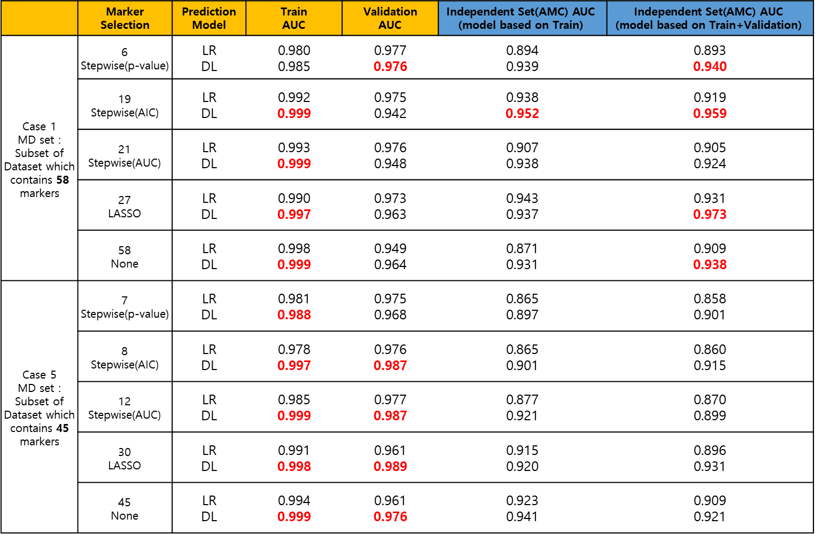
Result
 | Marker Selection | Prediction Model | $$\text{Train}$$ $$\text{AUC}$$ | $$\text{Validation}$$ $$\text{AUC}$$ | $$\text{Independent} \text{Set}\text{(}\text{AMC}\text{) }\text{AUC}$$ $$\text{(}\text{model} \text{based} \text{on} \text{Train}\text{)}$$ | $$\text{Independent} \text{Set}\text{(}\text{AMC}\text{) }\text{AUC}$$ $$\text{(}\text{model} \text{based} \text{on} \text{Train}\text{+}\text{Validation}\text{)}$$
Case 1 MD set : Subset of Dataset which contains 58 markers | 6 Stepwise(p-value) | LR DL | 0.980 0.985 | 0.977 0.976 | 0.894 0.939 | 0.893 0.940
 | 19 Stepwise(AIC) | LR DL | 0.992 0.999 | 0.975 0.942 | 0.938 0.952 | 0.919 0.959
 | 21 Stepwise(AUC) | LR DL | 0.993 0.999 | 0.976 0.948 | 0.907 0.938 | 0.905 0.924
 | 27 LASSO | LR DL | 0.990 0.997 | 0.973 0.963 | 0.943 0.937 | 0.931 0.973
 | 58 None | LR DL | 0.998 0.999 | 0.949 0.964 | 0.871 0.931 | 0.909 0.938
Case 5 MD set : Subset of Dataset which contains 45 markers | 7 Stepwise(p-value) | LR DL | 0.981 0.988 | 0.975 0.968 | 0.865 0.897 | 0.858 0.901
 | 8 Stepwise(AIC) | LR DL | 0.978 0.997 | 0.976 0.987 | 0.865 0.901 | 0.860 0.915
 | 12 Stepwise(AUC) | LR DL | 0.985 0.999 | 0.977 0.987 | 0.877 0.921 | 0.870 0.899
 | 30 LASSO | LR DL | 0.991 0.998 | 0.961 0.989 | 0.915 0.920 | 0.896 0.931
 | 45 None | LR DL | 0.994 0.999 | 0.961 0.976 | 0.923 0.941 | 0.909 0.921
Logistic regression with AACR markers
AACR | 0.989 (0.004) | 0.972 (0.014) | 0.952 (0.014) | 0.937 (0.018)

Slide 11
Multiple Peptide
Bertis Marker which we don’t have
Peptide
Gene Name | Peptide Sequence | Correlation
CLU | ASSIIDELFQDR | 0.73
 | TLLSNLEEAK
C5 | NADYSYSVWK | 0.78
 | GGSASTWLTAFALR
LRG1 | DLLLPQPDLR | 0.96
 | VAAGAFQGLR
ITIH4 | AGFSWIEVTFK | 0.77
 | LALDNGGLAR
BTD | ILSGDPYCEK | 0.92
 | LSSGLVTAALYGR
PPBP | NIQSLEVIGK | 0.83
 | ICLDPDAPR
SERPINC1 | IEDGFSLK | 0.84
 | VAEGTQVLELPFK
LDHB | GLTSVINQK | 0.79
 | IVVVTAGVR
CFH | GEWVALNPLR | 0.79
 | TGESVEFVCK
C4BPA | LSLEIEQLELQR | 0.88
 | TWYPEVPK
APOC1 | EFGNTLEDK | 0.91
 | EWFSETFQK
THBS1 | GFLLLASLR | 0.83
 | TIVTTLQDSIR
IGFBP3 | ALAQCAPPPAVCAELVR | 0.65
 | YGQPLPGYTTK
Gene Name | Peptide Sequence
TTR | AADDTWEPFASGK
KLKB1 | DSVTGTLPK
IGFBP2 | LIQGAPTIR
PROS1 | NNLELSTPLK
CFI | VFSLQWGEVK
C1R | DYFIATCK
C4BPB | ALLAFQESK
SOD3 | VTGVVLFR
MBL2 | FQASVATPR
ITIH2 | IQPSGGTNINEALLR
HRG | DGYLFQLLR
CTSD | VSTLPAITLK
C7 | VLFYVDSEK
C6 | TLNICEVGTIR
APOH | VCPFAGILENGAVR
AGT | DPTFIPAPIQAK
IFRD1 | GLIDLTLDK
ADIPOQ | GDIGETGVPGAEGPR
ECM1 | ELLALIQLER
C1S | TNFDNDIALVR
GSTP1 | ASCLYGQLPK
CORO1C | CDLISIPK
VIM | ILLAELEQLK
PTPRJ | DTEVLLVGLEPGTR
PKM2 | CDENILWLDYK
FCGBP | FAVLQENVAWGNGR
CPN2 | LSNNALSGLPQGVFGK
COL4A2 | GLPGEVLGAQPGPR
SERPINA5 | GFQQLLQELNQPR
SEPP1(SELENOP) | CINQLLCK
ICAM1 | LLGIETPLPK
Gene Name | Peptide Sequence
SERPINA5 | IVDLLK
SEPP1(SELENOP) | DDFLIYDR
ICAM1 | AQLLLK
SERPINC1 | LPGIVAEGR
CDH5 | VDAETGDVFAIER
PPIA | FEDENFILK
C2 | DHENELLNK
SERPINF2 | FDPSLTQR
KNG1 | DFVQPPTK
PF4 | TTSQVRPR
APOM | AFLLTPR
IGF2 | GFYFSRPASR

Slide 12
Hyperparameter Tuning of DL on Train/Validation
Activation function : Rectifier / Tanh / Maxout
Input dropout ratio : 0 / 0.05 / 0.1 / 0.2
Epochs : 20 /30 /40 /50 /60 /70 /80 /90 /100 /200 / 300 / 400 / 500 / 600 / 700 / 800
Epsilon : 1e-4 /1e-5 /1e-6 / 1e-7 / 1e-8 / 1e-9 / 1e-10
Train sample per iteration : 0 / -1 / -2
To specify one epoch, enter 0. To specify all available data, enter -1. To use the automatic values, enter -2
2688 combination

Slide 13
Peptide
ith(i>1) layers are fully connected
Network 1 itself are fully connected but they are not fully connected to each other.
ASSIIDELFQDR
CLU
TLLSNLEEAK
. . . .
(fully connected hidden layers)
C5
NADYSYSVWK
Output layer
GGSASTWLTAFALR
LRG1
DLLLPQPDLR
VAAGAFQGLR
. . . .
Input Layer

Slide 14
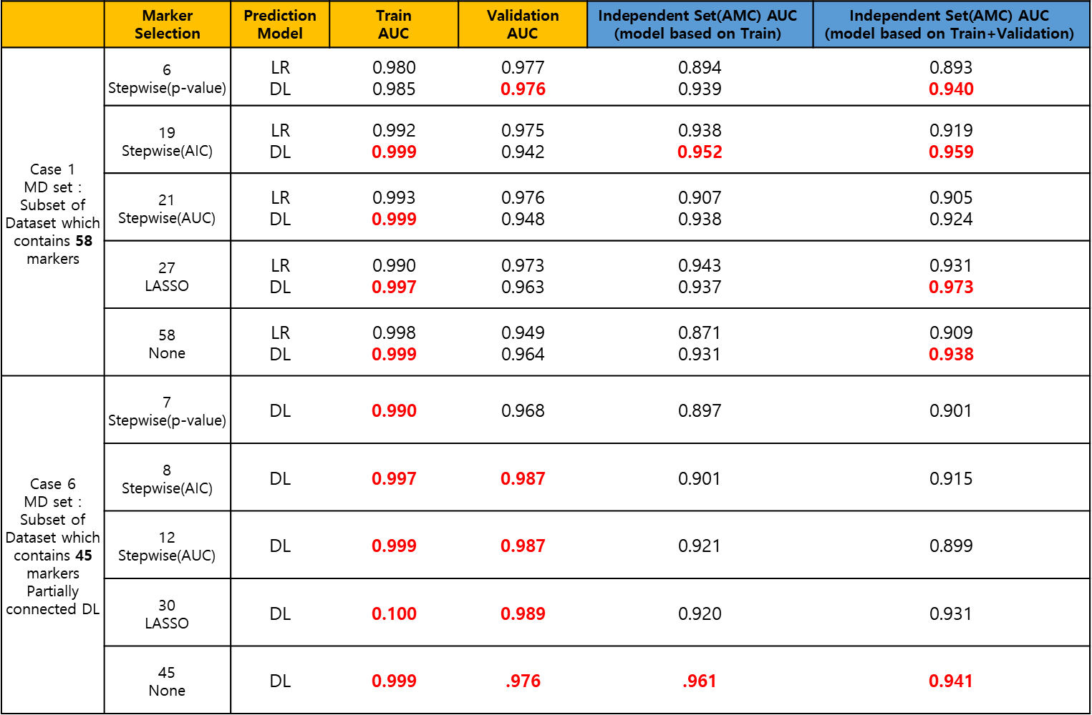
Result
 | Marker Selection | Prediction Model | $$\text{Train}$$ $$\text{AUC}$$ | $$\text{Validation}$$ $$\text{AUC}$$ | $$\text{Independent} \text{Set}\text{(}\text{AMC}\text{) }\text{AUC}$$ $$\text{(}\text{model} \text{based} \text{on} \text{Train}\text{)}$$ | $$\text{Independent} \text{Set}\text{(}\text{AMC}\text{) }\text{AUC}$$ $$\text{(}\text{model} \text{based} \text{on} \text{Train}\text{+}\text{Validation}\text{)}$$
Case 1 MD set : Subset of Dataset which contains 58 markers | 6 Stepwise(p-value) | LR DL | 0.980 0.985 | 0.977 0.976 | 0.894 0.939 | 0.893 0.940
 | 19 Stepwise(AIC) | LR DL | 0.992 0.999 | 0.975 0.942 | 0.938 0.952 | 0.919 0.959
 | 21 Stepwise(AUC) | LR DL | 0.993 0.999 | 0.976 0.948 | 0.907 0.938 | 0.905 0.924
 | 27 LASSO | LR DL | 0.990 0.997 | 0.973 0.963 | 0.943 0.937 | 0.931 0.973
 | 58 None | LR DL | 0.998 0.999 | 0.949 0.964 | 0.871 0.931 | 0.909 0.938
Case 6 MD set : Subset of Dataset which contains 45 markers Partially connected DL | 7 Stepwise(p-value) | DL | 0.990 | 0.968 | 0.897 | 0.901
 | 8 Stepwise(AIC) | DL | 0.997 | 0.987 | 0.901 | 0.915
 | 12 Stepwise(AUC) | DL | 0.999 | 0.987 | 0.921 | 0.899
 | 30 LASSO | DL | 0.100 | 0.989 | 0.920 | 0.931
 | 45 None | DL | 0.999 | .976 | .961 | 0.941
Logistic regression with AACR markers
AACR | 0.989 (0.004) | 0.972 (0.014) | 0.952 (0.014) | 0.937 (0.018)

Slide 15
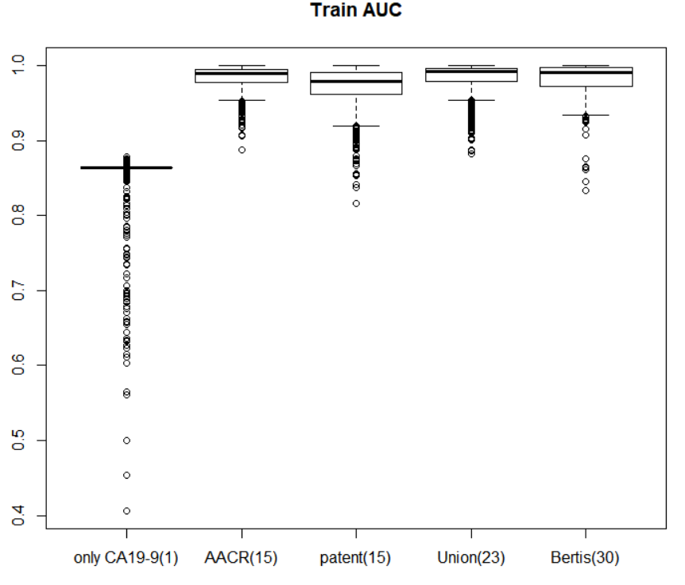
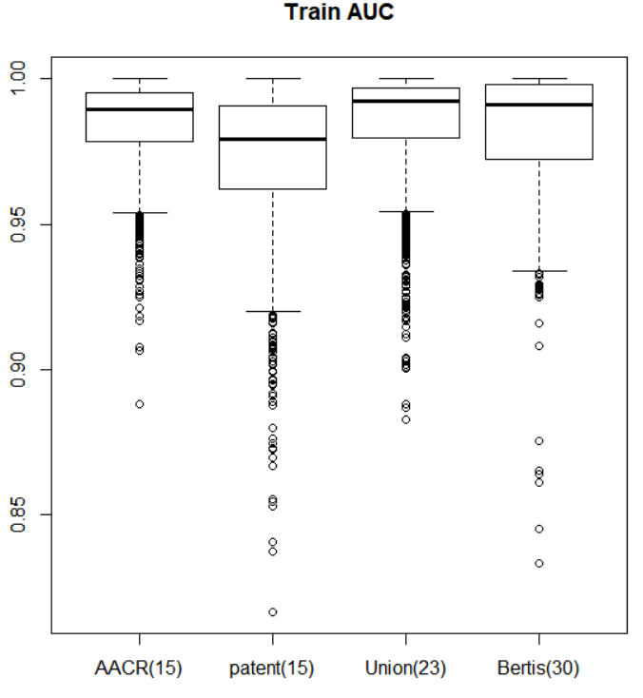
Summary : Train AUC for different combination of biomarkers

Slide 16
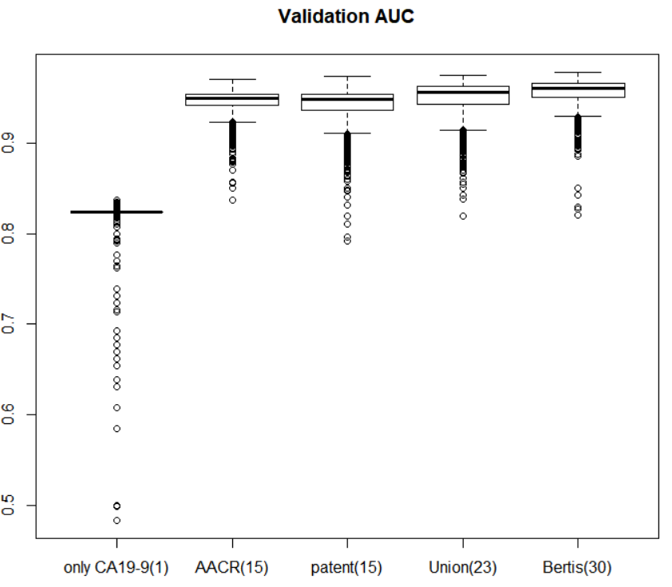
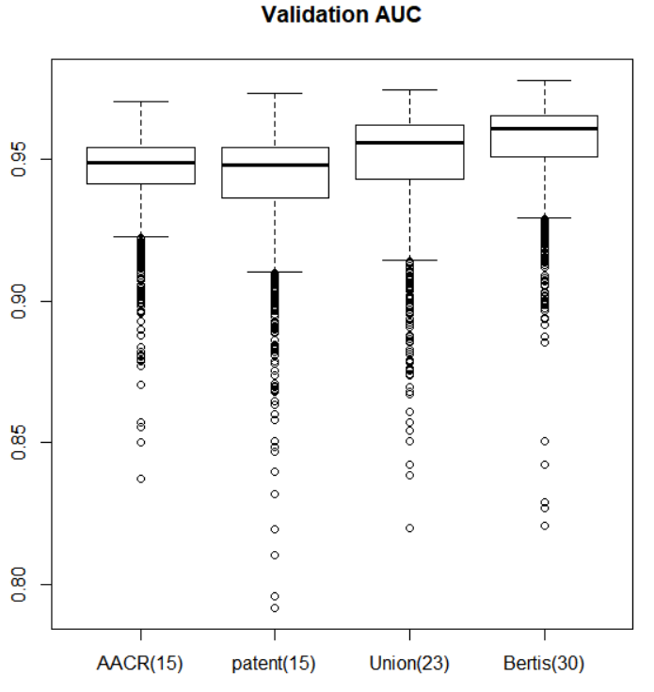
Summary : Validation AUC for different combination of biomarkers

